Slide 1

Computer Care & Handling
Creating a safe workspace
CBA
FW: 1.2.2 &1.2.3

Slide 2
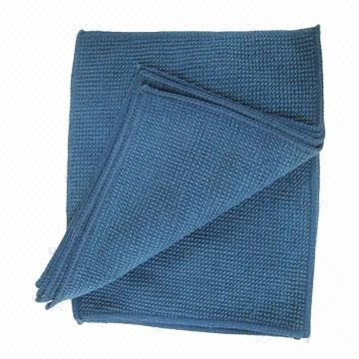

Keep It Clean!

Slide 3

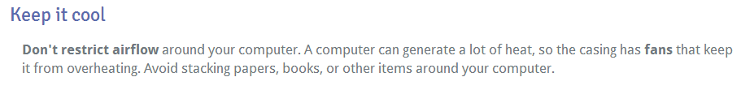
Keep It Cool!

Slide 4
Keep away from suspicious sites

Slide 5
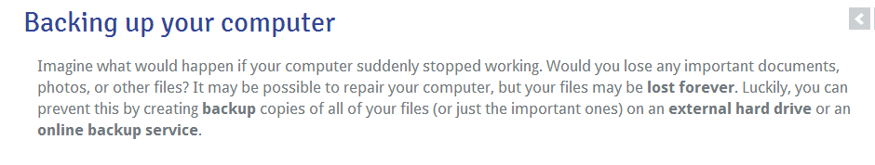


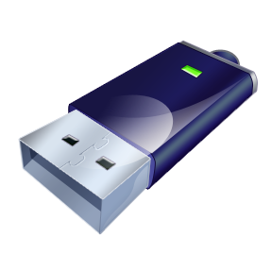

Keep a Back up!

Slide 6
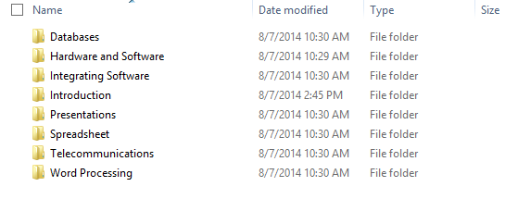
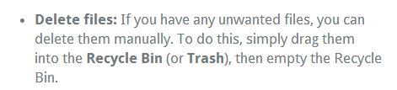
Keep it Organized!
Use File Management

Slide 7
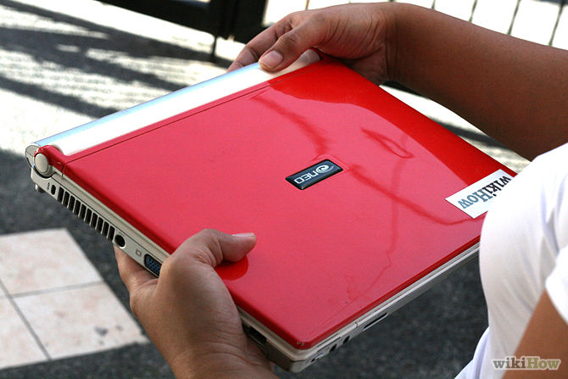
Keep a grip on it
Do Carry your laptop with two hands
Do hold the laptop by it’s base
Don’t carry it with one hand or carry it by the screen

Slide 8
Tips for Creating a safe
work space
Adjust your chair
Keep your keyboard at a comfortable height
Keep the mouse close to the keyboard
Place the monitor at a comfortable distance
Avoid clutter
Take frequent breaks

